Slide 1

Word Search Game
Vivek Vishwanath bhand
SY div-2 S3
MIS:111903129

Slide 2
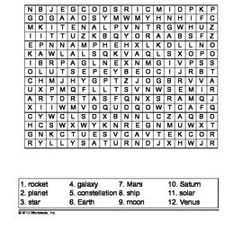
Objectives of mini project
Create user interactive word search game
Show correct entry from user as highlighted text
Show the hint at end to show all words stored.
Get introduced to ADT Trie data structure.

Slide 3
Approach to Project
Create new random puzzles
For each new attempt
Get input from user and begin the game
Show the correct answer and positions at end of game.

Slide 4
Dependancies
System Header file
<stdio.h>
<stdlib.h>
<time.h>
<windows.h>
<conio.h>
<string.h>
Defined header
<puzzle_create.h>
<entry.h>
<trie.h>
<solve.h>

Slide 5
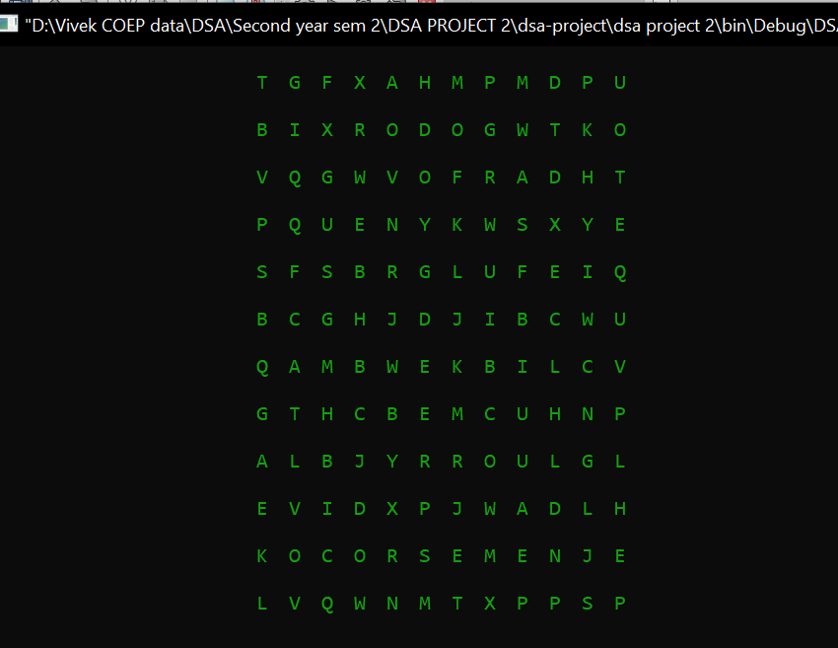
Creating Puzzle
Words to be inputted provided through txt file
Each of word are added at random orientation
Random alphabets are added to the extra spaces
12 X 12 puzzle is created
Store in a txt file
Updated during each entry

Slide 6
Functions
File containing target word is accessed.
Random row and columns are selected.
Words are added in any orientation, under condition that space is available.
Random letters are added to all remaining space

Slide 7
Prototypes
char **create2DArray();
void printArray(char **array);
void addWord_horizontal(char** mainArray, int stringArrIndex);
void addStringsToGrid(char** gameGrid);
int checkSpace_horizontal(int stringArrIndex, int randCol, int randRow);
void addWord_vertical(char** gameGrid ,int stringArrIndex);
int checkSpace_vertical(int stringArrIndex, int randCol, int randRow);
void addWord_diagonal(char** gameGrid ,int stringArrIndex);
int checkSpace_diagonal(int stringArrIndex, int randCol, int randRow);
void add_randomLetters(char** arr_2D);
void printArray_after(char **array);

Slide 8
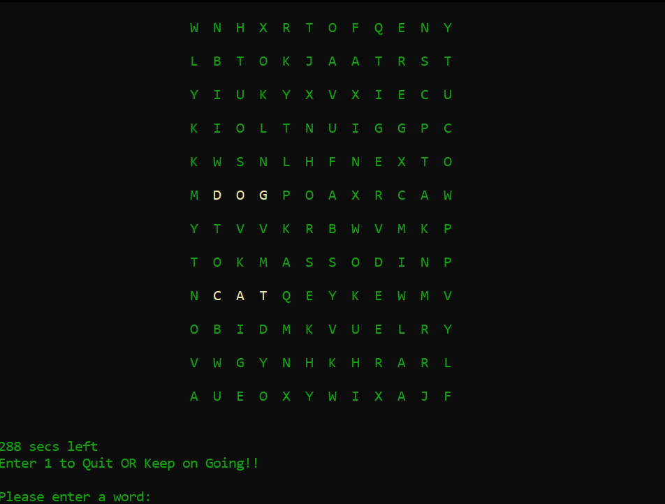
User entry
Start the timer
User entry is accepted.
Check if its it present in puzzle
If not , then retry
If present, show the word and its
location in highlighted text
If all words found, declare as winner
If time runs out, restart the game.

Slide 9
Functions
Takes and stores input
Checks if the word is present
Runs a timer
Print found words in highlighted color

Slide 10
Prototypes
void game_userEntry(char* word_file);
int game_matchesFound(int reset, int val);
void gameFunction(char* word_file);
void wordFoundColors(int word);
int **createCoordArray();
void print_coordIntArray(int **arr)

Slide 11
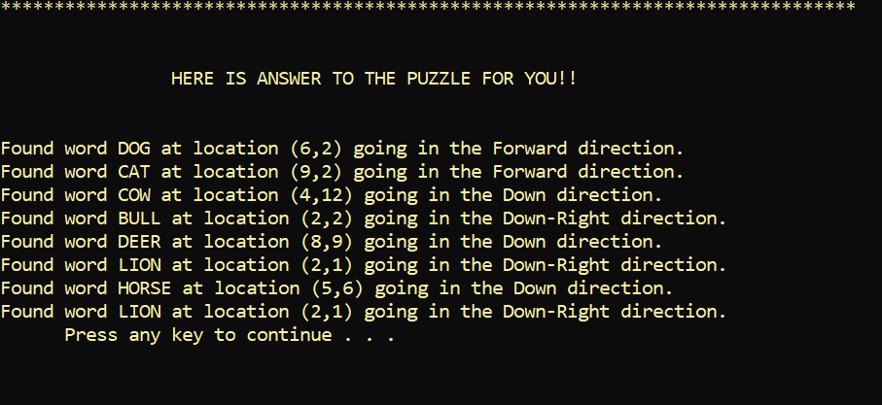
Show solution
After person gives up, hint is given
All words which are present in puzzle are
displayed.
It location and orientation are showed
to user

Slide 12
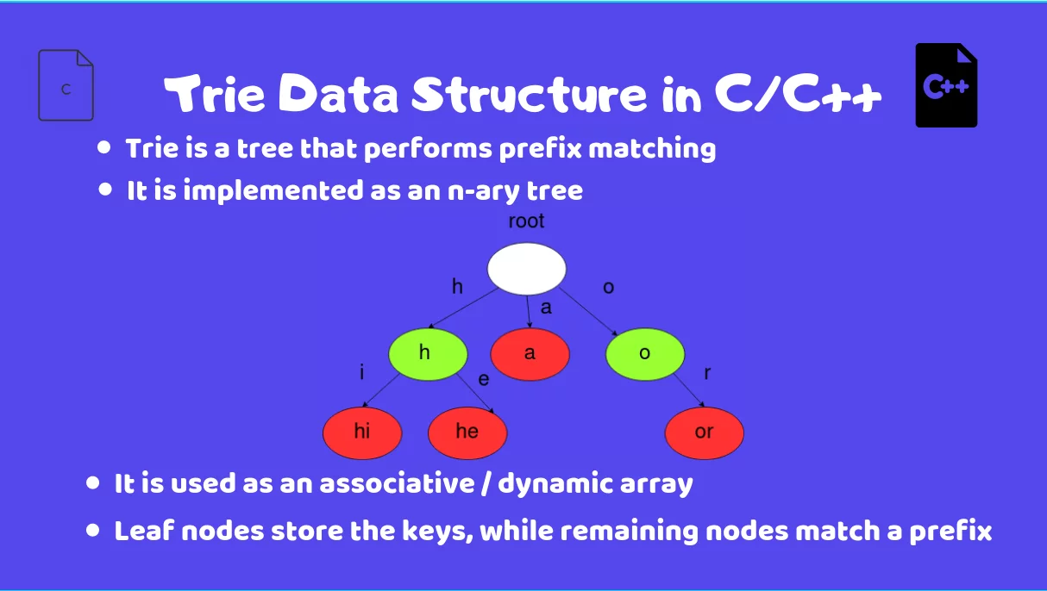
Trie data structure
It is based on tree data structure in c.
Consists of character variable, array of pointer
to its children and a integer marker to denote
a leaf node.
It is used to create dictionary, or auto complete
during search.

Slide 13
Prototypes
void readPuzzle(char puzzleFile[], char puzzle[PUZZLESIZE][PUZZLESIZE]);
int findWord(char word[], char puzzle[PUZZLESIZE][PUZZLESIZE], direction *dir, int *frow, int *fcol);
int searchRestOfWord(char word[], char puzzle[PUZZLESIZE][PUZZLESIZE], direction dir, int row, int col, int index);
void printPuzzle(char puzzle[PUZZLESIZE][PUZZLESIZE]);
void clue(char* puzzleFile,char *word);

Slide 14
Functions
Struct direction to store the orientation of found word.
Find the word present in the puzzle using trie data structure.
Read puzzle and word file
Find the word which is inserted and its location
Show the puzzle along the solution

